Slide 1

Software Engineering (2305CS202)
Unit-4 Software Coding, Testing
and Quality Management
Prof. Devangi L. Kotak
Darshan Institute of Computer Application
Devangi.kotak@darshan.ac.in

Slide 2

Looping
Outline
Code Review
Software Documentation
Testing Strategies
Testing Techniques and Test Case
Test Suites Design
Testing Conventional Applications
Testing Object Oriented Applications
Testing Web and Mobile Applications

Slide 3

Coding Standards
Most software development organizations formulate their own coding standards that suit them most, and require their engineers to follow these standards strictly
The purpose of requiring all engineers of an organization to adhere to a standard style of coding is the following:
A coding standard gives a uniform appearance to the codes written by different engineers.
Good software development organizations normally require their programmers to adhere to some well-defined and standard style of coding called coding standards.
It enhances code understanding.
It encourages good programming practices.

Slide 4

Coding Standards Cont.
A coding standard lists several rules to be followed such as, the way variables are to be named, the way the code is to be laid out, error return conventions, etc.
The following are some representative coding standards
1
Rules for limiting the use of global
These rules list what types of data can be declared global and what cannot.
2
Naming conventions for global & local variables & constant identifiers
A possible naming convention can be that global variable names always start with a capital letter, local variable names are made of small letters, and constant names are always capital letters.
3
Contents of the headers preceding codes for different modules
The information contained in the headers of different modules should be standard for an organization.
The exact format in which the header information is organized in the header can also be specified
The following are some standard header data
Module Name
Creation Date
Author’s Name
Modification history
information of the module
Global variables accessed/modified by the module
Different functions supported, along with their input/output parameters

Slide 5
Coding Standards Cont.
Sample Header
/*
* MyClass <br>
* This class is merely for illustrative purposes. <br>
*Revision History:<br>
* 1.1 – Added javadoc headers <br>
* 1.0 - Original release<br>
* @author D. L. Kotak
* @version 1.1, 12/02/2018
*/
public class MyClass {
. . .
}
4
Error return conventions and exception handling mechanisms
The way error conditions are reported by different functions in a program are handled should be standard within an organization.
For example, different functions while encountering an error condition should either return a 0 or 1 consistently.

Slide 6
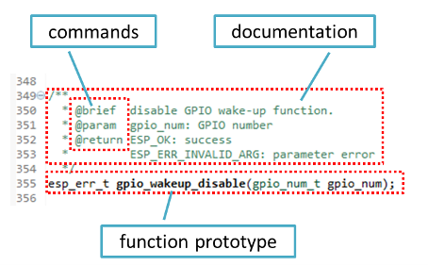
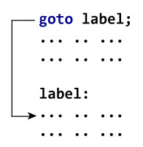
Coding guidelines
The following are some representative coding guidelines
Do not use a coding style that is too clever or too difficult to understand
Do not use an identifier for multiple purposes
Avoid obscure (unclear) side effects
The code should be well-documented
The side effects of a function call include modification of parameters passed by reference, modification of global variables, and I/O operations.
An obscure side effect is one that is not obvious(clear) from a casual examination of the code.
Obscure side effects make it difficult to understand a piece of code.
For example, if a global variable is changed obscurely in a called module or some file I/O is performed which is difficult to infer from the function’s name and header information, it becomes difficult for anybody trying to understand the code.
The length of any function should not exceed 10 source lines
Do not use goto statements
Well Documented
Do not use goto

Slide 7
Software Faults
Types of Faults
Quite unavoidable
Many reasons
Algorithmic
Logic is wrong Code reviews
Syntax
Wrong syntax; typos Compiler
Complex formulas, activities, algorithms
Computation/ Precision
Not enough accuracy
Documentation
Misleading documentation
Customer is often unclear of needs
Stress/Overload
Maximum load violated
Capacity/Boundary
Boundary cases are usually special cases
Size of software
Timing/Coordination
Synchronization issues Very hard to replicate
Number of people involved
Throughput/Performance
System performs below expectations
Software systems with large number of states
Recovery
System restarted from abnormal state
Hardware & related software
Compatibility issues
Standards
Non-compliance with industry standard

Slide 8



Software Quality
Software Quality remains an issue
Code Review
Code Walk Through
Code Inspection
Who is to blame?
Customers blame developers
Arguing that careless practices lead to low-quality software
Developers blame Customers & other stakeholders
Arguing that irrational delivery dates and continuous stream of changes force the to deliver software before it has been fully validated
Who is Right? Both – and that’s the problem

Slide 9
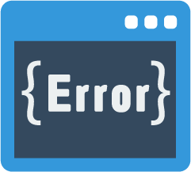


Code Review
Few classical programming errors
Code Review is carried out after the module is successfully compiled and all the syntax errors have been eliminated.
Code Reviews are extremely cost-effective strategies for reduction in coding errors and to produce high quality code.
Use of uninitialized variables
Jumps into loops
Nonterminating loops
Incompatible assignments
Array indices out of bounds
Improper storage allocation and deallocation
Mismatches between actual and formal parameter in procedure calls
Use of incorrect logical operators or incorrect precedence among operators
Improper modification of loop variables
Types of Reviews
Code Walk Through
Code Inspection

Slide 10

Code Review
Code Walk Through & Code Inspection
Code Walk Through
Code Inspection
Code walk through is an informal code analysis technique.
The main objectives of the walk through are to discover the algorithmic and logical errors in the code.
A few members of the development team are given the code few days before the walk through meeting to read and understand code.
Each member selects some test cases and simulates execution of the code by hand
The members note down their findings to discuss these in a walk through meeting where the coder of the module is present.
The aim of Code Inspection is to discover some common types of errors caused due to improper programming.
Code is examined for the presence of certain kinds of errors.
In addition, commitment to coding standards is also checked.
The author provides an overview of the project.
Inspection team performs code inspection.
Conduct a meeting with all team members and analyze the reviewed code.

Slide 11

Software Documentation
When various kinds of software products are developed, various kinds of documents are also developed as part of any software engineering process e.g..
Users’ manual
Design documents
Test documents
Installation manual
Software requirements specification (SRS) documents, etc
Different types of software documents can broadly be classified into the following:
Software Documents
Internal Documentation
External Documentation

Slide 12

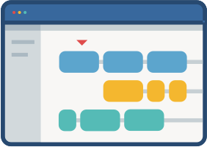
Software Documentation Cont.
Internal & External Documentation
Internal Documentation
External Documentation
It is the code understanding features provided as part of the source code.
It is provided through appropriate module headers and comments embedded in the source code.
It is also provided through the useful variable names, module and function headers, code structuring, use of enumerated types and constant identifiers, use of user-defined data types, etc.
Even when code is carefully commented, meaningful variable names are still more helpful in understanding a piece of code.
Good organizations ensure good internal documentation by appropriately formulating their coding standards and guidelines.
It is provided through various types of supporting documents
such as users’ manual
software requirements specification document
design document
test documents, etc.
A systematic software development style ensures that all these documents are produced in an orderly fashion.

Slide 13
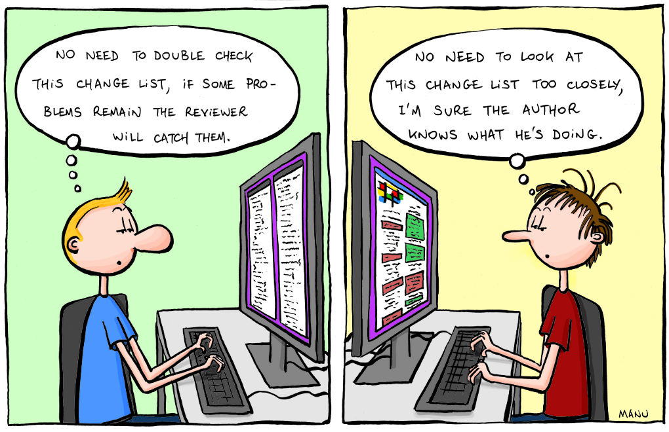


Software Testing
Testing is the process of exercising a program with the specific intent of finding errors prior to delivery to the end user.
Don’t view testing as a “safety net” that will catch all errors that occurred because of weak software engineering practice.

Slide 14


Who Test the Software
Tester
Who Test the Software?
Developer
Understands the system but, will test "gently"
and, is driven by "delivery"
Must learn about the system, but, will attempt to break it
and, is driven by quality
<Developer>
OR
Testing without plan is of no point
It wastes time and effort
Testing need a strategy Dev team needs to work with Test team, “Egoless Programming”
[Tester]

Slide 15
When to Test the Software?
Component Code
Component Code
Component Code
Unit Test
Unit Test
Unit Test
Design Specifications
Integration Test
Integrated modules
System functional requirements
Function Test
Functioning system
Other software requirements
Performance Test
Verified, validated software
Customer SRS
Acceptance Test
Accepted system
User environment
Installation Test
System in use!

Slide 16
Verification & Validation
Verification
Verification
Validation
Are we building the product right?
Process of evaluating products of a development phase to find out whether they meet the specified requirements.
Process of evaluating software at the end of the development to determine whether software meets the customer expectations and requirements.
The objective of Verification is to make sure that the product being develop is as per the requirements and design specifications.
Activities involved: Reviews, Meetings and Inspections
Activities involved: Testing like black box testing, white box testing, gray box testing
Validation
Carried out by QA team
Carried out by testing team
Are we building the right product?
Execution of code is not comes under Verification
Execution of code is comes under Validation
The objective of Validation is to make sure that the product actually meets the user’s requirements and check whether the specifications were correct in the first place.
Explains whether the outputs are according to inputs or not
Describes whether the software is accepted by the user or not
Cost of errors caught is less
Cost of errors caught is high

Slide 17
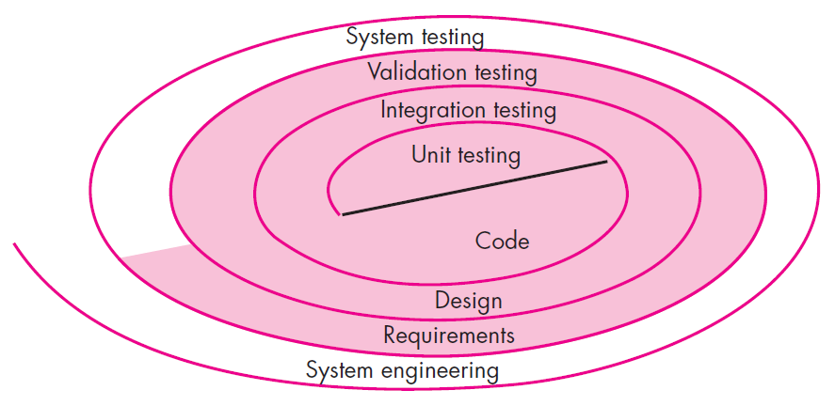

Software Testing Strategy
Unit Testing
It concentrate on each unit of the software as implemented in source code
Unit Testing
Integration Testing
Validation Testing
System Testing
It focuses on each component individual, ensuring that it functions properly as a unit.

Slide 18



Software Testing Strategy Cont.
Integration Testing
Validation Testing
System Testing
It focus is on design and construction of software architecture
Software is validated against requirements established as a part of requirement modeling
The software and other software elements are tested as a whole
Software once validated, must be combined with other system elements e.g. hardware, people, database etc…
Integration testing is the process of testing the interface between two software units or modules
It give assurance that software meets all informational, functional, behavioral and performance requirements
It verifies that all elements mesh properly and that overall system function / performance is achieved.

Slide 19
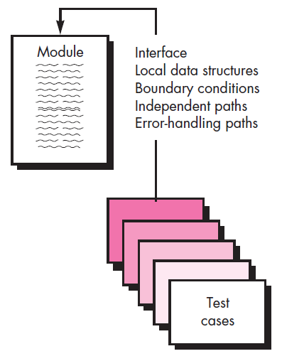
Unit Testing
Unit is the smallest part of a software system which is testable.
It may include code files, classes and methods which can be tested individually for correctness.
Unit Testing validates small building block of a complex system before testing an integrated large module or whole system
The unit test focuses on the internal processing logic and data structures within the boundaries of a component.
The module is tested to ensure that information properly flows into and out of the program unit
Local data structures are examined to ensure that data stored temporarily maintains its integrity during execution
All independent paths through the control structures are exercised to ensure that all statements in module have been executed at least once
Boundary conditions are tested to ensure that the module operates properly at boundaries established to limit or restricted processing
All error handling paths are tested

Slide 20
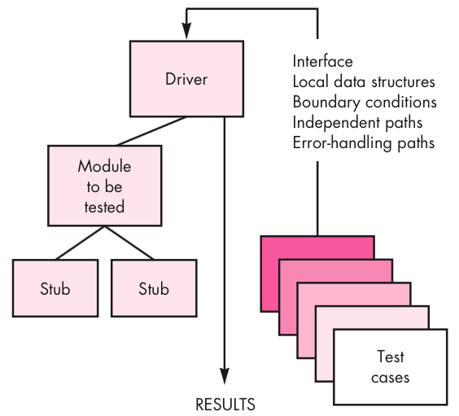
Driver & Stub (Unit Testing)
A
B
C
Let’s take an example to understand it in a better way.
Suppose there is an application consisting of three modules say, module A, module B & module C.
Developer has design in such a way that module B depends on module A & module C depends on module B
The developer has developed the module B and now wanted to test it.
But the module A and module C has not been developed yet.
In that case to test the module B completely we can replace the module A by Driver and module C by stub
Component-testing (Unit Testing) may be done in isolation from rest of the system
In such case the missing software is replaced by Stubs and Drivers and simulate the interface between the software components in a simple manner

Slide 21
Driver & Stub (Unit Testing) Cont.
Driver
Stub
Driver and/or Stub software must be developed for each unit test
A driver is nothing more than a " dummy main program"
Used in Bottom up approach
Lowest modules are tested first.
Simulates the higher level of components
Dummy program for Higher level component
Stubs serve to replace subordinate modules (called by) the component to be tested.
A stub is "dummy subprogram"
Used in Top down approach
Top most module is tested first
Simulates the lower level of components
Dummy program of lower level components

Slide 22
Integration Testing
Integration testing is the process of testing the interface between two software units or modules
It can be done in 3 ways
1. Big Bang Approach
2. Top Down Approach
3. Bottom Up Approach
Big Bang Approach
Top Down Approach
Combining all the modules once and verifying the functionality after completion of individual module testing
Testing take place from top to bottom
High level modules are tested first and then low-level modules and finally integrated the low level modules to high level to ensure the system is working as intended
Stubs are used as a temporary module, if a module is not ready for integration testing
Bottom Up Approach
Testing take place from bottom to up
Lowest level modules are tested first and then high-level modules and finally integrated the high level modules to low level to ensure the system is working as intended
Drivers are used as a temporary module, if a module is not ready for integration testing

Slide 23
Regression Testing
When to do regression testing?
Repeated testing of an already tested program, after modification, to discover any defects introduced or uncovered as a result of the changes in the software being tested
Regression testing is done by re-executing the tests against the modified application to evaluate whether the modified code breaks anything which was working earlier
Anytime we modify an application, we should do regression testing
It gives confidence to the developers that there is no unexpected side effects after modification
When new functionalities are added to the application
E.g. A website has login functionality with only Email. Now the new features look like “also allow login using Facebook”
When there is a change requirement
Forgot password should be removed from the login page
When there is a defect fix
E.g. assume that “Login” button is not working and tester reports a bug. Once the bug is fixed by developer, tester tests using this approach
When there is a performance issue
E.g. loading a page takes 15 seconds. Reducing load time to 2 seconds
When there is an environment change
E.g. Updating database from MySQL to Oracle
When to do regression testing?

Slide 24

Smoke Testing
Smoke Testing is an integrated testing approach that is commonly used when product software is developed
This test is performed after each Build Release
Smoke testing verifies – Build Stability
This testing is performed by “Tester” or “Developer”
This testing is executed for Integration Testing, System Testing & Acceptance Testing
What to Test?
All major and critical functionalities of the application is tested
It does not go into depth to test each functionalities
This does not incudes detailed testing for the build
Build
F1
F2
F3
F4
F5
F6
Critical
Critical
Major
Major
It test the build just to check if any major or critical functionalities are broken
If there are smoke or Failure in the build after Test, build is rejected and developer team is reported with the issue

Slide 25

Validation Testing
The process of evaluating software to determine whether it satisfies specified business requirements (client’s need).
It provides final assurance that software meets all informational, functional, behavioral, and performance requirements
When custom software is build for one customer, a series of acceptance tests are conducted to validate all requirements
It is conducted by end user rather then software engineers
If software is developed as a product to be used by many customers, it is impractical to perform formal acceptance tests with each one
Most software product builders use a process called alpha and beta testing to uncover errors that only the end user seems able to find

Slide 26
Validation Testing – Alpha & Beta Test
Alpha Test
The alpha test is conducted at the developer’s site by a representative group of end users
The software is used in a natural setting with the developer “looking over the shoulders” of the users and recording errors and usage problems
The alpha tests are conducted in a controlled environment
Beta Test
The beta test is conducted at one or more end-user sites
Developers are not generally present
Beta test is a “live” application of the software in an environment that can not be controlled by the developer
The customer records all problems and reports to the developers at regular intervals
After modifications, software is released for entire customer base

Slide 27
System Testing
In system testing the software and other system elements are tested.
System testing verifies that all elements mesh properly and overall system function/performance is achieved.
System testing is actually a series of different tests whose primary purpose is to fully exercise the computer-based system.
Types of System Testing
1
Recovery Testing
4
Performance Testing
2
Security Testing
5
Deployment Testing
3
Stress Testing

Slide 28


Types of System Testing
Recovery Testing
It is a system test that forces the software to fail in a variety of ways and verifies that recovery is properly performed.
If recovery is automatic (performed by the system itself)
Re-initialization, check pointing mechanisms, data recovery, and restart are evaluated for correctness.
If recovery requires human intervention
The mean-time-to-repair (MTTR) is evaluated to determine whether it is within acceptable limits
Security Testing
It attempts to verify software’s protection mechanisms, which protect it from improper penetration (access).
During this test, the tester plays the role of the individual who desires to penetrate the system.

Slide 29


Types of System Testing Cont.
Stress Testing
It executes a system in a manner that demands resources in abnormal quantity, frequency or volume.
A variation of stress testing is a technique called sensitivity testing.
Performance Testing
It is designed to test the run-time performance of software.
It occurs throughout all steps in the testing process.
Even at the unit testing level, the performance of an individual module may be tested.

Slide 30

Types of System Testing Cont.
Deployment Testing
It exercises the software in each environment in which it is to operate.
In addition, it examines
All installation procedures
Specialized installation software that will be used by customers
All documentation that will be used to introduce the software to end users

Slide 31

Acceptance Testing
It is a level of the software testing where a system is tested for acceptability.
The purpose of this test is to evaluate the system’s compliance with the business requirements.
It is a formal testing conducted to determine whether or not a system satisfies the acceptance criteria with respect to user needs, requirements, and business processes
It enables the customer to determine, whether or not to accept the system.
It is performed after System Testing and before making the system available for actual use.

Slide 32
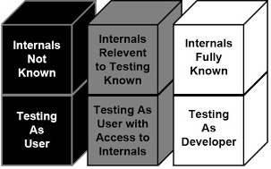
Views of Test Objects
Black Box Testing
White Box Testing
Grey Box Testing
Close Box Testing
Testing based only on specification
Open Box Testing
Testing based on actual source code
Partial knowledge of source code

Slide 33
Black Box Testing
Also known as specification-based testing
Tester has access only to running code and the specification it is supposed to satisfy
Test cases are written with no knowledge of internal workings of the code
No access to source code
So test cases don’t worry about structure
Emphasis is only on ensuring that the contract is met
Advantages
Scalable; not dependent on size of code
Testing needs no knowledge of implementation
Tester and developer can be truly independent of each other
Tests are done with requirements in mind
Does not excuse inconsistencies in the specifications
Test cases can be developed in parallel with code

Slide 34
Black Box Testing Cont.
Disadvantages
Test Case Design
Test size will have to be small
Specifications must be clear, concise, and correct
May leave many program paths untested
Weighting of program paths is not possible
Examine pre-condition, and identify equivalence classes
All possible inputs such that all classes are covered
Apply the specification to input to write down expected output
Test Case 1
Input: x1 (sat. X)
Exp. Output: y1
Test Case 2
Input: x2 (sat. X)
Exp. Output: y2
Specification
Operation op
Pre: X
Post: Y
Specification-
Based Test Case
Design

Slide 35
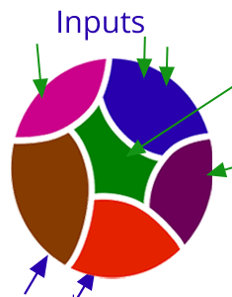
Black Box Testing Cont.
Exhausting testing is not always possible when there is a large set of input combinations, because of budget and time constraint.
The special techniques are needed which select test-cases smartly from the all combination of test-cases in such a way that all scenarios are covered
Two techniques are used
1
Equivalence Partitioning
2
Boundary Value Analysis (BVA)
Equivalence Partitioning
Input data for a program unit usually falls into a number of partitions, e.g. all negative integers, zero, all positive numbers
Each partition of input data makes the program behave in a similar way
Two test cases based on members from the same partition is likely to reveal the same bugs

Slide 36
Equivalence Partitioning (Black Box Testing)
By identifying and testing one member of each partition we gain 'good' coverage with 'small' number of test cases
Testing one member of a partition should be as good as testing any member of the partition
Example - Equivalence Partitioning
For binary search the following partitions exist
Inputs that confirm to pre-conditions (sorted array, valid key).
Inputs where the precondition is false (unsorted array).
Inputs where the key element is a member of the array
Inputs where the key element is not a member of the array
Pick specific conditions of the array
The array has a single value
Array length is even
Array length is odd

Slide 37
Equivalence Partitioning (Black Box Testing) Cont.
Example - Equivalence Partitioning
Example: Assume that we have to test field which accepts SPI (Semester Performance Index) as input (SPI range is 0 to 10)
SPI
* Accepts value 0 to 10
Equivalence Partitioning
Invalid | Valid | Invalid
<=-1 | 0 to 10 | >=11
Valid Class: 0 – 10, pick any one input test data from 0 to 10
Invalid Class 1: <=-1, pick any one input test data less than or equal to -1
Invalid Class 2: >=11, pick any one input test data greater than or equal to 11

Slide 38

Example: Two test case values based on members from the same partition
SPI
* Accepts value 0 to 10
Equivalence Partitioning
Invalid | Valid | Invalid
<=-1 | 0 to 10 | >=11
Values-1
-2.3
6
13
Values-2
-4.7
9
44
Result
Not accept/Error msg
Accept
Not accept/Error msg

Slide 39
Examples: Equivalence Partitioning classes
Age Validation: Age:
Valid Class: Ages between 18 and 65 (assuming adult eligibility).
Invalid Class 1: Ages less than 18
Invalid Class 2: greater than 65.‍
‍Username Field: Username: * ( (a-z, A-Z, 0-9) and
underscores ).
Valid Class: Alphanumeric characters (a-z, A-Z, 0-9) and underscores (_).
Invalid Class 1: Special characters
Invalid Class 2: Operators
Invalid Class 3: Empty username, username exceeding a certain length, and empty space before, in-between, and after the username.

Slide 40
Boundary Value Analysis (BVA) (Black Box Testing)
It arises from the fact that most program fail at input boundaries
Boundary testing is the process of testing between extreme ends or boundaries between partitions of the input values.
In Boundary Testing, Equivalence Class Partitioning plays a good role
Boundary Testing comes after the Equivalence Class Partitioning
The basic idea in boundary value testing is to select input variable values at their:
Just below the minimum
Minimum
Just above the minimum
Just below the maximum
Maximum
Just above the maximum
Boundary
Boundary Values

Slide 41
Boundary Value Analysis (BVA) (Black Box Testing)
Suppose system asks for “a number between 100 and 999 inclusive”
The boundaries are 100 and 999
We therefore test for values
99 100 101
998 999 1000
Lower boundary
Upper boundary
BVA - Advantages
It is easier and faster to find defects using this technique because the probability of defects at boundaries is more.
Instead of testing all sets of test data, we only pick the one at the boundaries. So, the overall test execution time reduces.
The procedure and guidelines are crystal clear and easy when it comes to determining the test cases through BVA.
The test cases generated through BVA are very small.

Slide 42
Boundary Value Analysis (BVA) (Black Box Testing) Cont.
BVA - Disadvantages
The success of the testing using this technique depends on the equivalence classes identified, which further depends on the expertise of the tester and his knowledge of the application. Hence, incorrect identification of equivalence classes leads to incorrect boundary value testing.
Applications with open boundaries or applications not having one-dimensional boundaries are not suitable for this technique. In those cases, other black-box techniques like “Domain Analysis” are used.
This technique doesn’t fit well when it comes to Boolean Variables.

Slide 43
Examples: Boundary Value Analysis (BVA)
*Ages between 18 and 65 (assuming adult eligibility).
Example: Age Validation: Age:
17 18 19
64 65 67
Lower boundary
Upper boundary

Slide 44
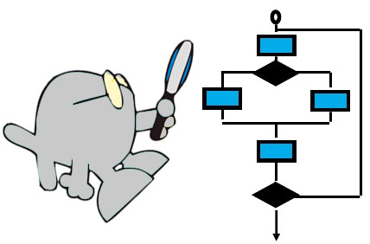
White Box Testing
Also known as structural testing
White Box Testing is a software testing method in which the internal structure/design/implementation of the module being tested is known to the tester
Focus is on ensuring that even abnormal invocations are handled gracefully
Using white-box testing methods, you can derive test cases that
Guarantee that all independent paths within a module have been exercised at least once
Exercise all logical decisions on their true and false sides
Execute all loops at their boundaries
Exercise internal data structures to ensure their validity
...our goal is to ensure that all statements and conditions have been executed at least once ...

Slide 45
White Box Testing Cont.
It is applicable to the following levels of software testing
Unit Testing: For testing paths within a unit
Integration Testing: For testing paths between units
System Testing: For testing paths between subsystems
Advantages
Disadvantages
Testing can be commenced at an earlier stage as one need not wait for the GUI to be available.
Testing is more thorough, with the possibility of covering most paths
Since tests can be very complex, highly skilled resources are required, with thorough knowledge of programming and implementation
Test script maintenance can be a burden, if the implementation changes too frequently
Since this method of testing is closely tied with the application being testing, tools to cater to every kind of implementation/platform may not be readily available

Slide 46
White-box testing strategies
One white-box testing strategy is said to be stronger than another strategy, if all types of errors detected by the first testing strategy is also detected by the second testing strategy, and the second testing strategy additionally detects some more types of errors.
White-box testing strategies
1
Statement coverage
2
Branch coverage
3
Path coverage
Statement coverage
It aims to design test cases so that every statement in a program is executed at least once
Principal idea is unless a statement is executed, it is very hard to determine if an error exists in that statement
Unless a statement is executed, it is very difficult to observe whether it causes failure due to some illegal memory access, wrong result computation, etc.
Statement coverage =
No of statements Executed / Total no of statements in the source code * 100

Slide 47
Statement Coverage: White-box testing strategies Cont.
Consider Finding greater number from given two number algorithm
Read A
Read B
if A > B
Print “A is greater than B”
else
Print "B is greater than A"
endif
Case 1: A>B (A=6 & B=3)
No of statements Executed: 5
Total no of statements in the source code: 7
Statement coverage =5/7*100 = 71.00 %
Case 2: A<B (A=3 & B=6)
No of statements Executed: 6
Total no of statements in the source code: 7
Statement coverage =6/7*100 = 85.20 %

Slide 48
Statement Coverage: White-box testing strategies Cont.
Consider the Euclid’s GCD computation algorithm
int compute_gcd(x, y)
int x, y;
{
1 while (x! = y){
2 if (x>y) then
3 x= x – y;
4 else y= y – x;
5 }
6 return x;
}
By choosing the test set {(x=3, y=3), (x=4, y=3), (x=3, y=4)}, we can exercise the program such that all statements are executed at least once.

Slide 49
White-box testing strategies Cont.
Branch coverage
In the branch coverage based testing strategy, test cases are designed to make each branch condition to assume true and false values in turn
It is also known as edge Testing as in this testing scheme, each edge of a program’s control flow graph is traversed at least once
Branch coverage guarantees statement coverage, so it is stronger strategy compared to Statement Coverage.
Decision coverage can be calculated using the formula below:
Decision coverage = (No of Decision Executed / Total no of Decision )* 100

Slide 50
White-box testing strategies Cont.
Path Coverage
In this strategy test cases are executed in such a way that every path is executed at least once
All possible control paths taken, including
All loop paths taken zero, once and multiple items in technique
The test case are prepared based on the logical complexity measure of the procedure design
Flow graph, Cyclomatic Complexity and Graph Metrices are used to arrive at basis path.
Cyclomatic Complexity is calculated by developing a Control Flow Graph of the code.
Cyclomatic Complexity can be represented using the below formula:
Cyclomatic complexity = E - N + 2*P
where,
E = number of edges in the flow graph (here E=6).
N = number of nodes in the flow graph (here N=5).
P = number of nodes that have exit points (here P=1).
For a single program (or subroutine or method), P is always equal to 1
1
2
3
5
4

Slide 51
Grey Box Testing
Combination of white box and black box testing
Tester has access to source code, but uses it in a restricted manner
Test cases are still written using specifications based on expected outputs for given input
These test cases are informed by program code structure

Slide 52

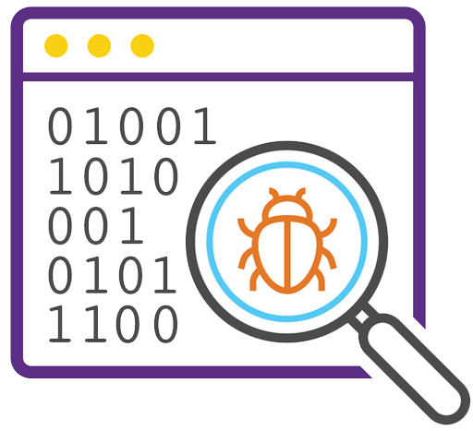
Testing Object Oriented Applications
Unit Testing in the OO Context
The concept of the unit testing changes in object-oriented software
Encapsulation drives the definition of classes and objects
Means, each class and each instance of a class (object) packages attributes (data) and the operations (methods or services) that manipulate these data
Rather than testing an individual module, the smallest testable unit is the encapsulated class
Unlike unit testing of conventional software,
which focuses on the algorithmic detail of a module and the data that flows across the module interface,
class testing for OO software is driven by the operations encapsulated by the class and the state behavior of the class

Slide 53
Integration Testing in the OO Context
Object-oriented software does not have a hierarchical control structure,
conventional top-down and bottom-up integration strategies have little meaning
There are two different strategies for integration testing of OO systems.
Thread-based testing
integrates the set of classes required to respond to one input or event for the system
Each thread is integrated and tested individually
Regression testing is applied to ensure that no side effects occur
Use-based testing
begins the construction of the system by testing those classes (called independent classes) that use very few (if any) of server classes
After the independent classes are tested, the next layer of classes, called dependent classes, that use the independent classes are tested
Cluster testing is one step in the integration testing of OO software
Here, a cluster of collaborating classes is exercised by designing test cases that attempt to uncover

Slide 54
Validation Testing in an OO Context
At the validation or system level, the details of class connections disappear
Like conventional validation, the validation of OO software focuses on user-visible actions and user-recognizable outputs from the system
To assist in the derivation of validation tests, the tester should draw upon use cases that are part of the requirements model
Conventional black-box testing methods can be used to drive validation tests

Slide 55


Testing Web Applications
WebApp testing is a collection of related activities with a single goal to uncover errors in WebApp content, function, usability, navigability, performance, capacity, and security
To accomplish this, a testing strategy that encompasses both reviews and executable testing is applied.
Dimensions of Quality
Content is evaluated at both a syntactic and semantic level.
At the syntactic level spelling, punctuation, and grammar are assessed for text-based documents.
At a semantic level correctness of information presented, Consistency across the entire content object and related objects, and lack of ambiguity are all assessed.

Slide 56
Dimensions of Quality Cont.
Function is tested to uncover errors that indicate lack of conformance to customer requirements
Structure is assessed to ensure that it properly delivers WebApp content
Usability is tested to ensure that each category of user is supported by the interface and can learn and apply all required navigation.
Navigability is tested to ensure that all navigation syntax and semantics are exercised to uncover any navigation errors
Ex., dead links, improper links, and erroneous links
Performance is tested under a variety of operating conditions, configurations and loading
to ensure that the system is responsive to user interaction and handles extreme loading
Compatibility is tested by executing the WebApp in a variety of different host configurations on both the client and server sides
Interoperability is tested to ensure that the WebApp properly interfaces with other applications and/or databases
Security is tested by assessing potential vulnerabilities

Slide 57
Testing Web Applications
Content Testing
User Interface Testing
Component-Level(Functionality) Testing
Navigation Testing
Configuration Testing
Security Testing
Performance Testing

Slide 58
Content Testing
User Interface Testing
Content testing ensures that all textual, visual, and multimedia elements within the application are accurate, engaging, and correctly presented.
Content testing includes proofreading text for spelling and grammar, ensuring images and videos load properly, and checking that multimedia elements display as intended.
For example, in a news application, content testing would involve verifying that articles load fully, images are high-quality, and any embedded media plays correctly across devices.
WebApp user interface testing occurs at three distinct points
During requirements analysis
the interface model is reviewed to ensure that it conforms to stakeholder requirements
During design
the interface design model is reviewed to ensure that generic quality criteria established for all user interfaces have been achieved
During testing
the focus shifts to the execution of application-specific aspects of user interaction
User interface tests are performed from the end user’s perspective.

Slide 59
Component-Level Testing
Navigation Testing
Component-level testing (function testing), focuses on a set of tests that attempt to uncover errors in WebApp functions.
Each WebApp function is a software component (implemented in one of a variety of programming languages)
WebApp function can be tested using black-box (and in some cases, white-box) techniques.
Component-level test cases are often driven by forms-level input.
Once forms data are defined, the user selects a button or other control mechanism to initiate execution.
The job of navigation testing is to ensure that
the mechanisms that allow the WebApp user to travel through the WebApp are all functional
Navigation mechanisms should be tested are
Navigation links,
Redirects,
Bookmarks,
Frames and framesets,
Site maps,
Internal search engines.

Slide 60
Configuration Testing
Security Testing
Configuration testing is to test a set of probable client-side and server-side configurations
to ensure that the user experience will be the same on all of them and,
to isolate errors that may be specific to a particular configuration
Hardware, operating system(s), browsers, storage capacity, network communication speeds, and a variety of other client-side factors are difficult to predict for each user.
One user’s impression of the WebApp and the manner in which he/she interacts with it can differ significantly.
Security tests are designed to review
vulnerabilities of the client-side environment,
the network communications that occur as data are passed from client to server and back again, and
the server-side environment.
Each of these domains can be attacked, and it is the job of the security tester to uncover weaknesses
that can be exploited by those with the intent to do so.

Slide 61
Performance Testing
Performance testing is used to uncover
performance problems that can result from lack of server-side resources,
inappropriate network bandwidth,
inadequate database capabilities,
faulty or weak operating system capabilities,
poorly designed WebApp functionality, and
other hardware or software issues that can lead to degraded client-server performance

Slide 62

Looping
Outline
Quality Concepts
Software Quality Assurance
SQA Activities
Statistical SQA
Software Reviews (Formal Technical Reviews)
Software Reliability
The Quality Standards
ISO 9000
CMM
Six Sigma for SE
SQA Plan

Slide 63
What is Quality
Quality
Developed product meets it’s specification
Software Quality Assurance (SQA)
Software quality assurance (also called quality management) is an umbrella activity that is applied throughout the software process
It is planned and systematic pattern of activities necessary to provide high degree of confidence in the quality
Quality Management
Ensuring that required level of product quality is achieved
Defining procedures and standards
Applying procedures and standards to the product and process
Checking that procedures are followed
Collecting and analyzing various quality data

Slide 64
SQA Activities
SQA Management Plan
Prepare an SQA plan for a project
Make a plan for how you will carry out the SQA through out the project.
Think about which set of software engineering activities are the best for project.
Check level of SQA team skills.
Set The Check Points
SQA team should set checkpoints.
Evaluate the performance of the project on the basis of collected data on different check points.
Multi testing Strategy
Do not depend on a single testing approach.
When you have a lot of testing approaches available use them.

Slide 65
SQA Activities
Measure Change Impact
The changes for making the correction of an error sometimes re-introduces more errors keep the measure of impact of change on project.
Reset the new change to check the compatibility of this fix with whole project.
Manage Good Relations
In the working environment managing good relations with other teams involved in the project development is mandatory.
Bad relation of SQA team with programmers team will impact directly and badly on project. Don’t play politics.

Slide 66
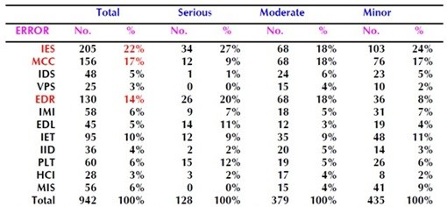
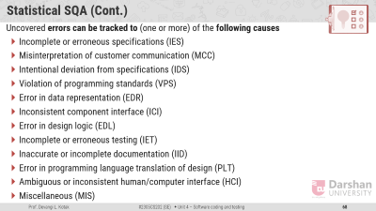

Statistical Software Quality Assurance
Statistical quality assurance is used to identify the potential variations in the manufacturing process and predict potential defects.
Incomplete or erroneous specifications
Misinterpretation of customer communication
Intentional deviation from specifications
All full name

Slide 67
Statistical Software Quality Assurance
Statistical quality assurance is used to identify the potential variations in the manufacturing process and predict potential defects.
Statistical quality assurance implies the following steps:
Information about software defects is collected and categorized
An attempt is made to trace each defect to its underlying cause
Ex., non-conformance to specifications, design error, violation of standards, poor communication with the customer
Using the Pareto principle (80 percent of the defects can be traced to 20 percent of all possible causes), isolate the 20 percent (the "vital few").
Once the vital few causes have been identified, move to correct the problems that have caused the defects.
Some of the defects are uncovered as software is being developed.
Other are encountered after the software has been released.

Slide 68

Statistical SQA (Cont.)
Uncovered errors can be tracked to (one or more) of the following causes
Incomplete or erroneous specifications (IES)
Misinterpretation of customer communication (MCC)
Intentional deviation from specifications (IDS)
Violation of programming standards (VPS)
Error in data representation (EDR)
Inconsistent component interface (ICI)
Error in design logic (EDL)
Incomplete or erroneous testing (IET)
Inaccurate or incomplete documentation (IID)
Error in programming language translation of design (PLT)
Ambiguous or inconsistent human/computer interface (HCI)
Miscellaneous (MIS)

Slide 69
Software Reviews (Formal Technical Reviews)
A formal technical review (FTR) is a software quality control activity performed by software engineers (and others)
The objectives of an FTR are:
To uncover errors in function, logic, or implementation; for any representation of the software
To verify that the software under review meets its requirements
To ensure that the software has been represented according to predefined standards
To achieve software that is developed in a uniform manner
To make projects more manageable
During the FTR,
a reviewer (the recorder) actively records all issues that have been raised
These are summarized at the end of the review meeting, and a reviewed issues list is produced.

Slide 70
Review Guidelines
Guidelines for conducting formal technical reviews must be
established in advance, distributed to all reviewers, agreed upon & then followed
Review the product, not the producer
Set an agenda and maintain it
Limit debate and denial
Speak problem areas, but don't attempt to solve every problem noted
Take written notes
Conduct meaningful training for all reviewers
Limit the number of participants and insist upon advance preparation
Develop a checklist for each product that is likely to be reviewed
Allocate resources and schedule time for FTRs
Review your early reviews

Slide 71

Differentiation of SQA & SQC
Criteria
SQA
SQC
Definition
SQA is a set of activities for ensuring quality in software engineering processes (that ultimately result in quality in software products). The activities establish and evaluate the processes that produce products
SQC is a set of activities for ensuring quality in software products. The activities focus on identifying defects in the actual products produced
Focus
Process focused
Product focused
Orientation
Prevention oriented
Detection oriented
Breadth
Organization wide
Product/project specific
Scope
Relates to all products that will ever be created by a process
Relates to specific product
Activities
Process Definition and Implementation, Audits, Training
Reviews, Testing

Slide 72

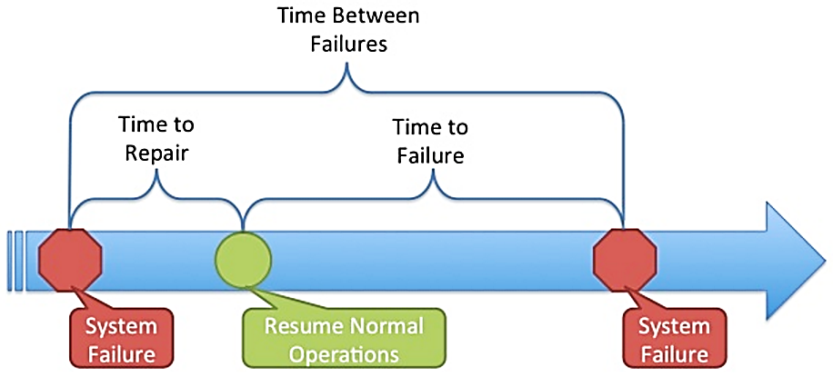
Software Reliability
Software reliability is defined in statistical terms as
Measures of Reliability
Many researchers argue that MTBF is a far more useful measure than other quality-related software metrics
An end user is concerned with failures, not with the total defect count
Because each defect contained within a program does not have the same failure rate, the total defect count provides little indication of the reliability of a system
An alternative measure of reliability is failures-in-time (FIT)
a statistical measure of how many failures a component will have over one billion hours of operation
The probability of failure-free operation of a computer program in a specified environment for a specified time
A simple measure of reliability is meantime-between-failure (MTBF):
MTBF = MTTF + MTTR
MTTF = mean-time-to-failure, MTTR = mean-time-to-repair

Slide 73



The quality standards
ISO 9001
ISO 9000 and 9001
Six Sigma
CMM
In order to bring quality in product and service, many organizations are adopting Quality Assurance System
ISO standards are issued by the International Organization for Standardization (ISO) in Switzerland
Proper documentation is an important part of an ISO 9001 Quality Management System.
ISO 9001 is the quality assurance standard that applies to software engineering
It includes, requirements that must be present for an effective quality assurance system
ISO 9001 standard is applicable to all engineering discipline

Slide 74
ISO 9001 Cont.
The requirements described by ISO 9001:2000 address topics such as
Management Responsibility
Quality System
In order for a software organization to become registered to ISO 9001:2000
Design Control
Document
Product Identification
Traceability
1. It must establish policies and procedures to address each of the requirements just noted
Inspection
Testing
Control of Quality Records
Internal Quality
Training
Servicing
2. Able to demonstrate that these policies and procedures are being followed
Contract Review
Process Control
Data Control
Preventive Action
Audits

Slide 75
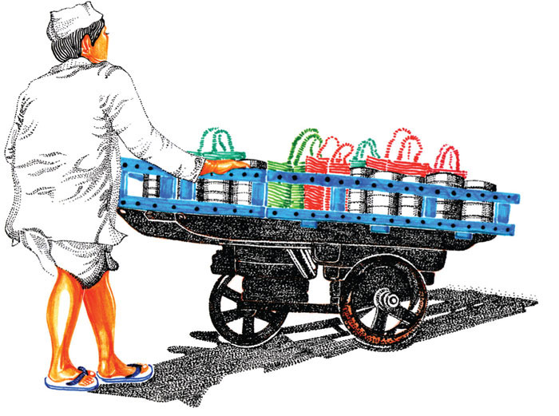
Six Sigma
Mumbai's
Dabbawalas
Six Sigma is a method used by organizations to improve the quality of their processes. It focuses on reducing mistakes and improving efficiency.
Six Sigma is a disciplined, data-driven approach and methodology for reducing defects in any process - from manufacturing to transactional and from product to service.
To achieve six sigma, a process must not produce more than 3.4 defects per million opportunities
4 Sigma → 6210 defects per million opportunities
5 Sigma → 230 defects per million opportunities
Example of Six Sigma Company
For over 100 years they have delivered food to every part of the city, earning them a Six Sigma rating (a Forbes rating of 99.9 % which means one error in 6 million transactions).

Slide 76

DMAIC & DMADV methodologies of Six sigma
Six sigma have two methodologies.
DMAIC methodologies
DMADV methodologies
Used if an existing software process is already there but improvement is required.
Define: Define customer requirement, deliverables and project goals via customer communication
Measure: Measure the existing process and its output to determine current quality performance
Analyze: Analyze the root cause of the problem or design and identify the way in which it can be improved to meet customer requirements.
Improve: Improve the process to fix the problem. Once you know the causes of the problems, present solutions for them and implement them.
Control: Control the process to ensure the problem doesn’t return.
Used if organization is developing a software process.
Define, Measure and analyze are similar to above method.
Design: Design the process to avoid the root cause of defect and to meet customer requirements.
Verify: Verify that the process model will avoid defect and meet customer requirements.

Slide 77
List of Six Sigma companies
3M
Amazon
Atos
Autoliv
BAE Systems
Bank of America
Becton Dickinson
Bechte
Boeing
Caterpillar Inc.
Computer Sciences Corporation
Convergys
Cooper Tire & Rubber Company
Credit Suisse
Damco
Deere & Company
Dell
Denso
Eastman Kodak Company
Evonik Industries
Ford Motor Company
General Electric
Google
Inventec
Maersk
Sears
Motorola
McKesson Corporation
Mumbai's dabbawalas
Northrop Grumman
PolyOne Corporation
Raytheon
Shop Direct
Unipart
United States Army
United States Marine Corps
The Vanguard Group
Wipro

Slide 78
CMM (Capability Maturity Model)
To determine an organization’s current state of process maturity, the SEI (Software Engineering Institute) uses an assessment that results in a five point grading scheme
The grading scheme determines compliance with a capability maturity model (CMM) that defines key activities required at different levels of process maturity
The SEI approach establishes five process maturity levels that are defined in the following manner
Level 1: Initial
The software process is characterized as ad hoc and occasionally
Few processes are defined and success depends on individual effort
Level 2: Repeatable
Basic project management processes are established to track cost, schedule, and functionality.
The necessary process discipline is in place to repeat earlier successes on Project
Level 3: Defined
The software process for both management and engineering activities is documented, standardized and integrated
This level includes all characteristics defined for level 2

Slide 79
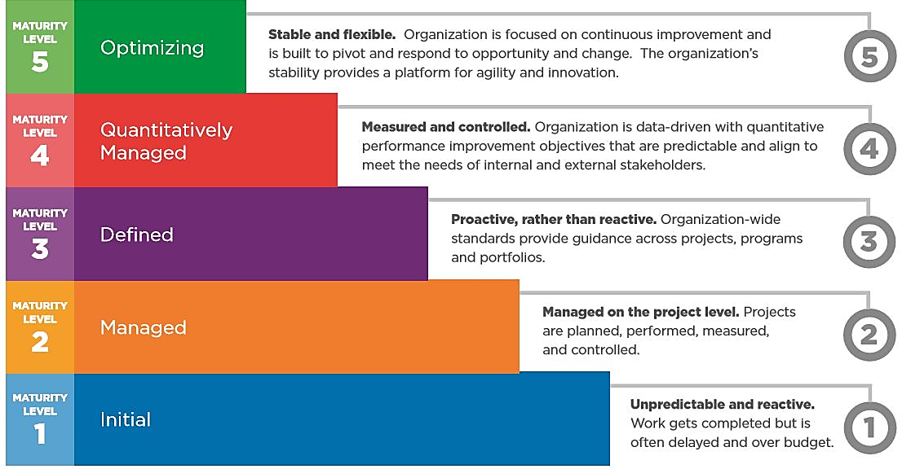
CMM (Capability Maturity Model) Cont.
Level 4: Managed
Detailed measures of the software process and product quality are collected
This level includes all characteristics defined for level 3
Level 5: Optimizing
Continuous process improvement is enabled by quantitative feedback from the process and from testing innovative ideas and technologies
This level includes all characteristics defined for level 4
Repeatable

Slide 80
What is a Test Scenario?
A Test Scenario is defined as any functionality that can be tested.
It is also called Test Condition or Test Possibility.
Test Scenario gives the idea of what we have to test.
Test Scenario is like a high-level test case.
Test Scenario answers “What to be tested”
As a Tester, You should put yourself in the end user’s and figure out the real-world scenario and use cases of the Application Under Test.
For example, Testing the login Page. What are the scenarios that the user is expected to go through?

Slide 81
Login Test Scenarios
Verify that the Login form contains Username, Password, Login Button, Register here (for new user)
Verify that tab functionality is working properly or not
Verify that Enter/Tab key works as a substitute for the Submit button
Verify that all the fields such as Username, Password fields have a valid placeholder
Verify that the labels float upward when the text field is in focus or filled (In case of floating label).
Verify the login functionality

Slide 82
What is a Test Case?
Test cases are the set of positive and negative executable steps of a test scenario.
Test Case answers “How to be tested”
Test Case templates include: Test Case Title, Preconditions, Inputs Data, Test Steps, Expected Results, Postconditions, Status, and developed based on test conditions.
Assume that we need to test the functionality of a login page.
Test cases for the login page functionality as follows:
Enter a valid User Name and valid Password
Enter a valid User Name and invalid Password
Enter invalid User Name and valid Password
Enter invalid User Name and invalid Password

Slide 83
Example of Test Case
Title | Login with a valid username & password
Precondition | User is already registered using valid credentials
Test Steps | 1. Enter a valid username 2. Enter a valid password 3. Click on sign in
Expected Result | -User is logged in successfully -User is redirected to Home page
Test Suite | Login
Test Environment | Samsung Galaxy Note 10 - Android 10 – 4G Network
Actual Result | Same as expected
Status | Pass

Slide 84
Software Engineering (2305CS202)
Prof. Devangi L. Kotak
Darshan Institute of Computer Application
Devangi.kotak@darshan.ac.in

